Slide 1
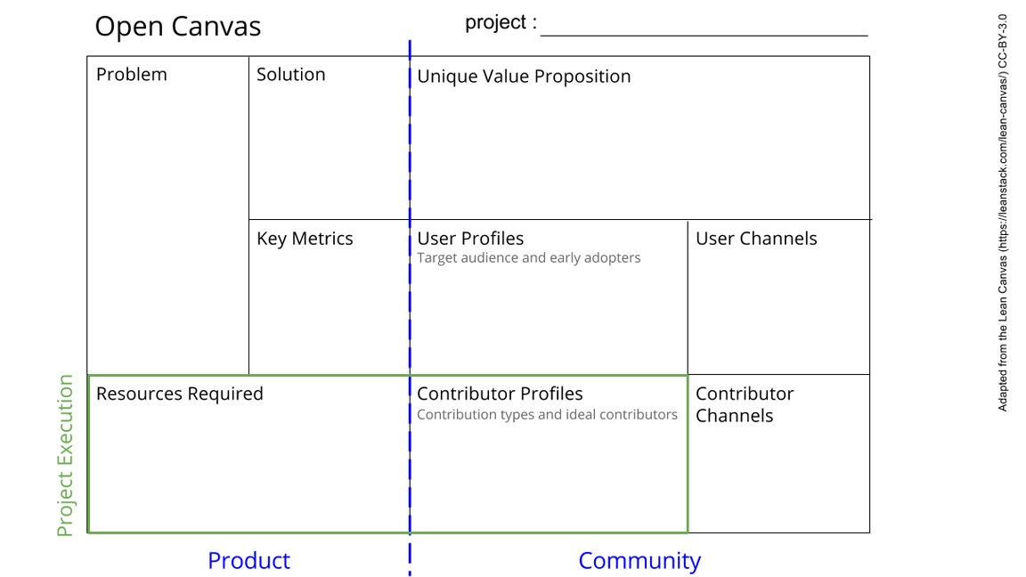
Lack of disaggregate data of how corruption impacts differently on women over men.
Create awareness of how corruption impacts women
Create an open learning platform with a recopilation of real stories of how corruption affects the lives of women
Create and spread knowledge about the differentiated impacts of corruption on women through storytelling
#of stories
#of contribuitors
#of users
Journalists
Partnerships with the cohort
Social media
hackathon
Journalists
Anticorruption adovocates
Gender advocates, policymakers
MVP
Developers
Good writing skills. Indicate where, how, result and who(no names)
Universities, gender students, wikimedia, mozilla sprints
See next slide for instructions!
Notes:
Go to File > Make a Copy… to make your own canvas
See next slide for instructions

Slide 2
